Slide 1
Updating an Excel Chart Deck from Access with the Click of a Button
Purpose:
Import AS400 detail data each Monday
Update the Chart deck information
Distribute spreadsheet to staff via email

Slide 2
Steps
Import data from AS400
Massage the Data in Access
(Create the Chart Deck template– one time)
Copy the template to a new spreadsheet
From Access, update the data for each Chart
Present the spreadsheet to the screen
All with very little code!
One chart deck has about ~100 lines of code, and of that, 11 lines are repeated with slightly different values for each of 9 charts

Slide 3
Files Users Need
NoStocks.accdb
  All in one database (not front/back end)
TemplateExternal.xls
TemplateInternal.xls
  Want 2003 compatible Excel
These files can be on any computer in any folder. All 3 must be present. The folder will also be where the spreadsheets will saved if the users does not save them somewhere else.

Slide 4
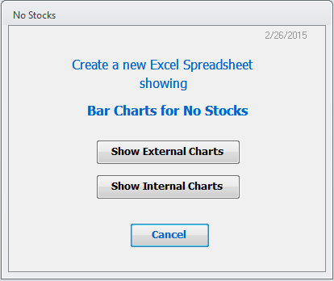
Demo Application
I will demo Internal Charts first, which has ~20 tabs of data
See spreadsheet Charts, data lists, behind the scene chart data

Slide 5
In Excel
(this is where we are going)
1. 1st get your summarized data
(easiest to design charts if you have data)
2. Design the charts
3. Keep spreadsheet as your template
Demo designing a chart/template!

Slide 6
Import data from AS400
This is really set up by others
Need access and rights to data
Once data is linked via ODBC, it is just another Access table
In my presentation, I have already imported the new data.

Slide 7
Access VBA Code
Skim tables
Skim queries
See code module
We will come back to the tables and queries as there are a few tricks I had to use.

Slide 8
Some Gotchas
Want column titles as dates (not week #)
Dates given should be Mondays
Show full weeks of data only
Plants don’t have data each week (causes a problem when chart is expecting 12 columns of data)

Slide 9
Massage the Data in Access
See AS400 raw data that is imported
Need to sum by Week
Need to sum by Day
Need to sum by Plant
Need to be sure there is a record for each Plant for each week
>Go through the queries to create the data

Slide 10
Review Code for Updating Excel and lastly show External Chart Deck

